Slide 1
Finlatics
Data Science with Python
Topic
Media and Technology
By
Soumya Saha

Slide 2
Introduction
In the youtube statistics dataset, we delve into the fascinating world of YouTube, a platform that has revolutionized content creation and consumption globally. Our focus is on analyzing a comprehensive dataset of YouTube giants, offering an invaluable glimpse into the dynamics of top creators and their channels. In this project, I explore various metrics such as subscriber counts, video views, upload frequencies, earnings, and geographical distribution among top content creators. This dataset provides a treasure trove of information, allowing us to uncover patterns and insights that can benefit aspiring content creators, data enthusiasts, marketers, and anyone intrigued by the ever-evolving online content landscape. Through my analysis, I aim to answer key questions about what drives success on YouTube, how different factors correlate with audience engagement and revenue, and what trends are emerging in this vibrant ecosystem.By immersing ourselves in the world of YouTube success, we unlock a wealth of knowledge that can guide content strategies, enhance understanding of digital media dynamics, and perhaps inspire the next generation of YouTube stars. Let's dive in and explore the data-driven insights that this extraordinary dataset has to offer.

Slide 3
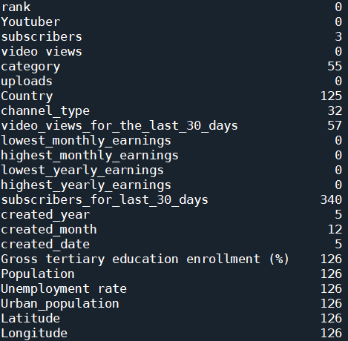
Data Pre-processing
In the dataset, six columns are identified as unnecessary: ‘Title’, ‘Country of origin’, ‘Abbreviation’, ‘video_views_rank’, ‘country_rank’, and ‘channel_type_rank’. Consequently, these columns have been dropped to streamline the data.
These are the number of NaN values in every column. In the ‘subscribers’ columns, the NaN values are replaced by median value of this column. Next, for the two columns ‘category’ and ‘channel type’ all rows where both columns are empty are removed. The missing values in the ‘category’ column are then filled using the corresponding values from the ‘channel type’ column, and vice versa. After some renaming and additional processing steps, all missing values in these two columns are filled. For the numerical columns such as "video_views_for_the_last_30_days," "subscribers_for_last_30_days," "Gross tertiary education enrollment (%)," "Population," "Unemployment rate," and "Urban_population," the missing values are filled with their respective median values.

Slide 4
Data Pre-processing
There are approximately 125 YouTube channels where the "Country" is unknown. Deleting these rows would result in a significant loss of data, so a placeholder name "Unknown" is used to fill these missing values. If the mode was used, it could have a significant bias. For the "created_year," "created_month," and "created_date" columns, the mode is used to fill their missing values. After all these preprocessing steps, the dataset, which originally had 1006 rows and 29 columns, is reduced to 1002 rows and 23 columns.

Slide 5
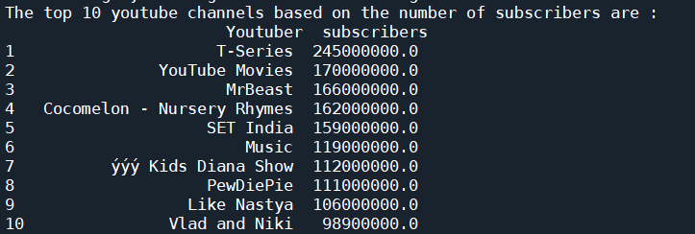
Question 1:
What are the top 10 YouTube channels based on the number of subscribers?
As we are seeing from the output console, the top 10 Youtube channels based on the number of subscribers are T-Series, Youtube Movies, MrBeast, Cocomelon - Nursery Rhymes, SET India, Music, ýýý Kids Diana Show, PewDiePie, Like Nastya, Vlad and Niki.

Slide 6
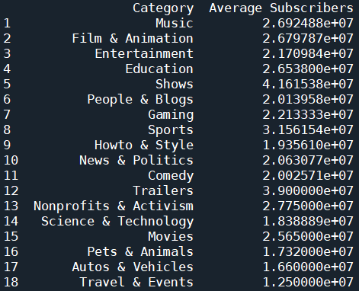
Question 2:
Which category has the highest average number of subscribers?
As we can see , Shows category has highest average number of subscribers (41615384.62).

Slide 7
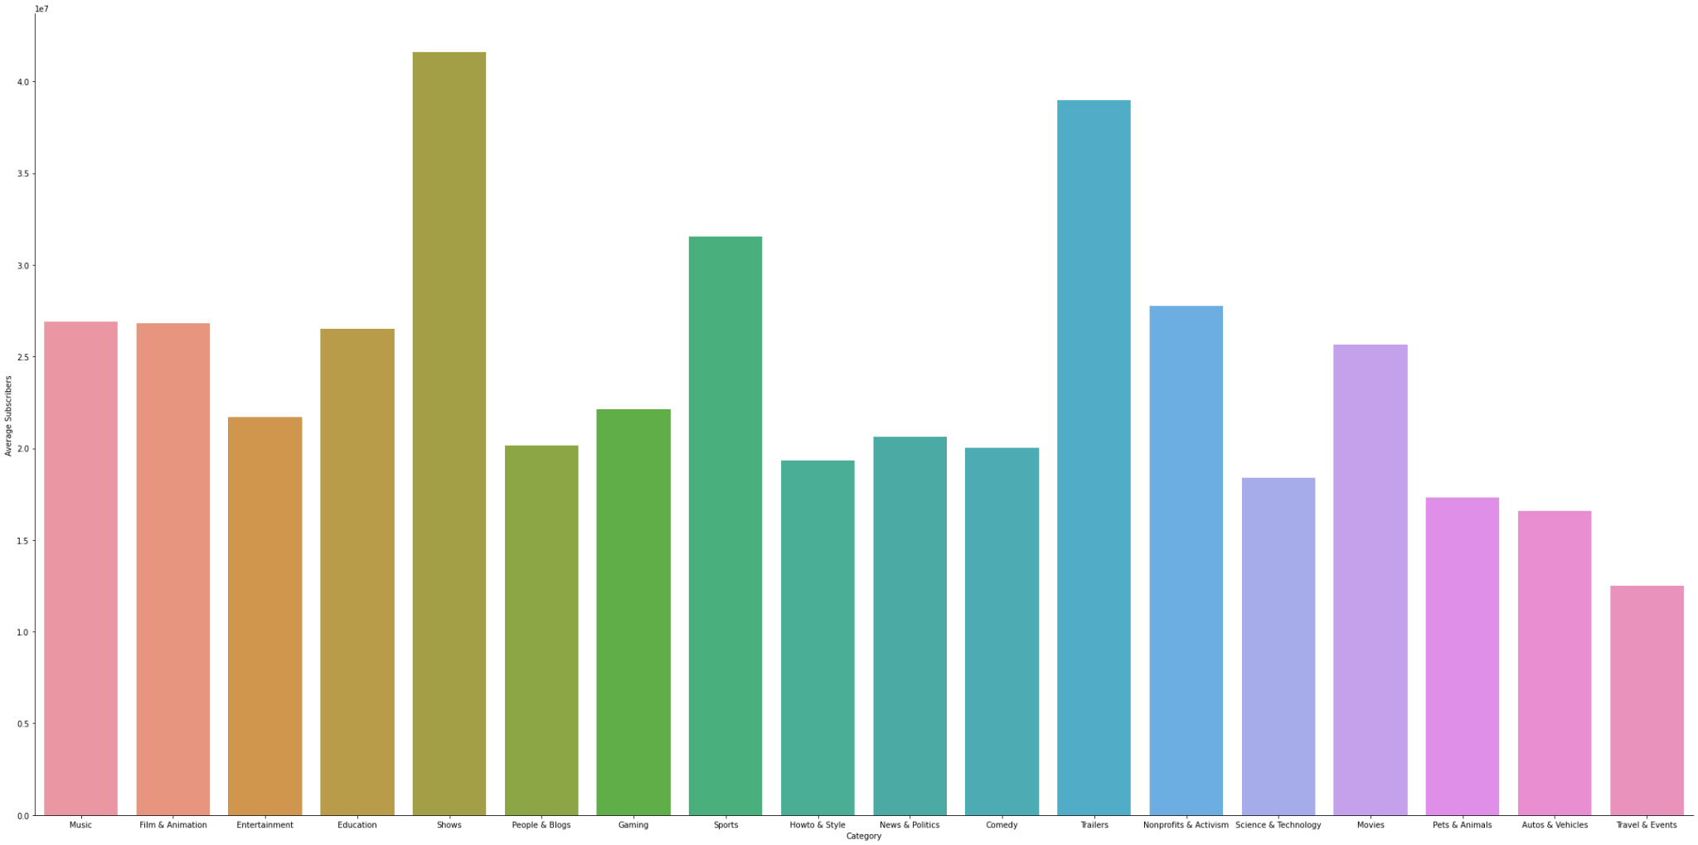
From this plot,it is also clear Shows category has highest number of average subscribers.

Slide 8
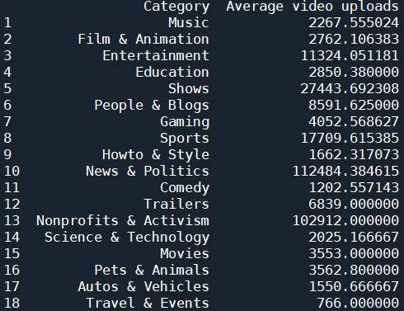
Question 3:
How many videos, on average, are uploaded by YouTube channels in each category?

Slide 9
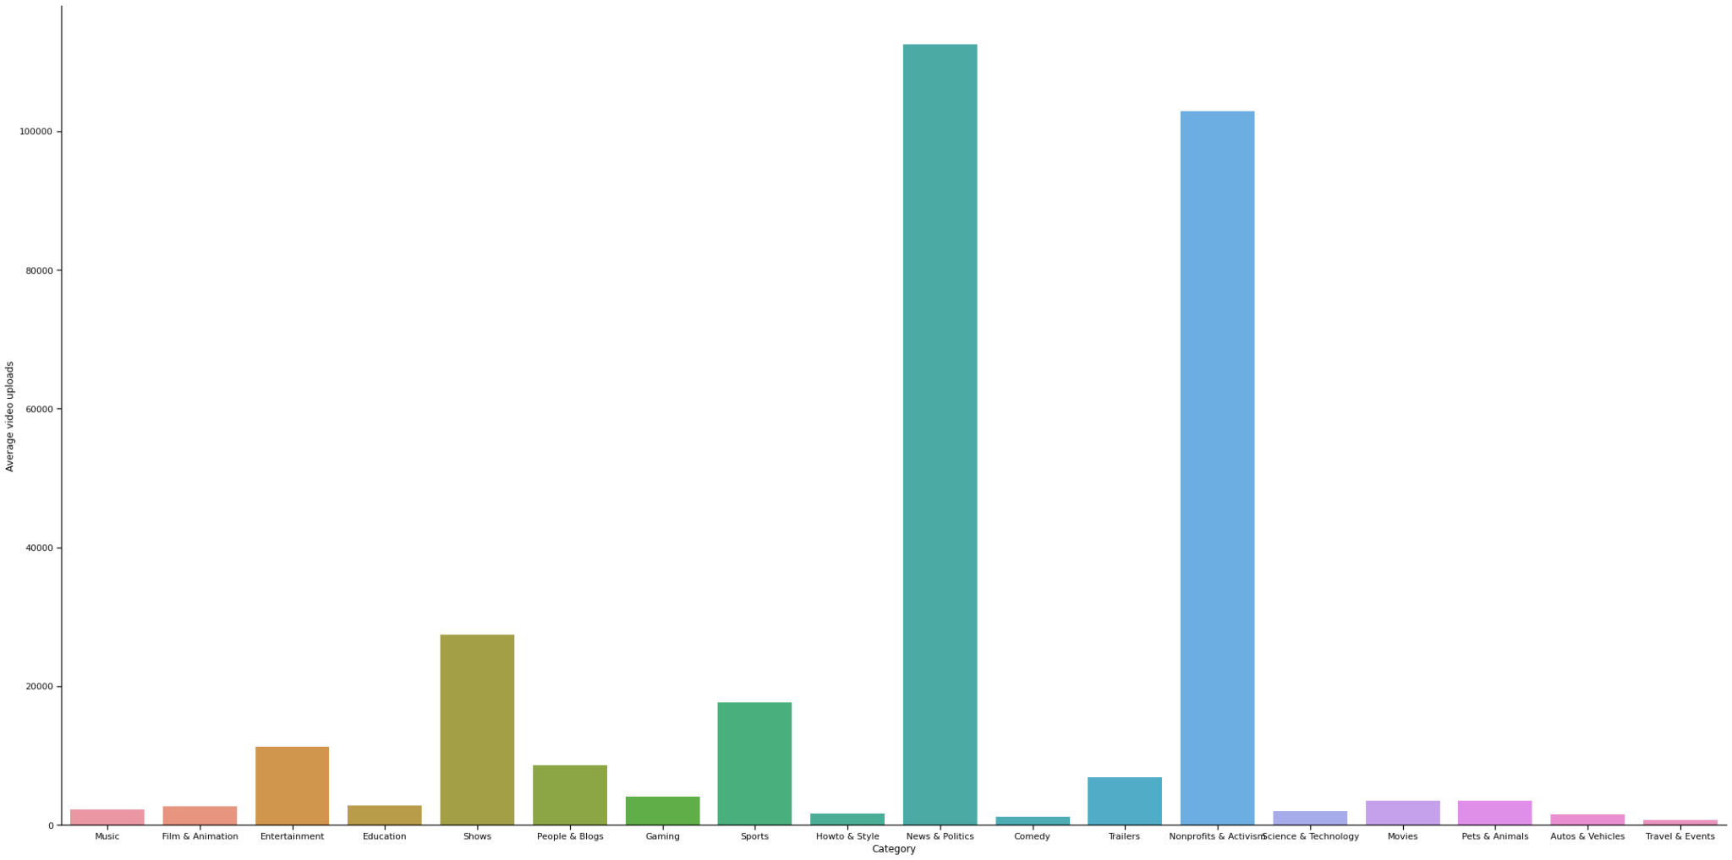
Plot showing the Average video uploads vs Category

Slide 10
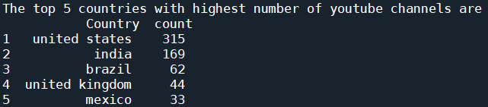
Question 4:
What are the top 5 countries with the highest number of YouTube channels?
The top 5 countries with highest number of youtube channels are United States(315), India(169), Brazil(62), United Kingdom(44), Mexico(33).

Slide 11
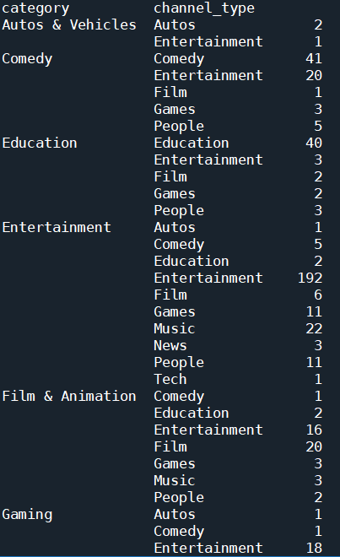

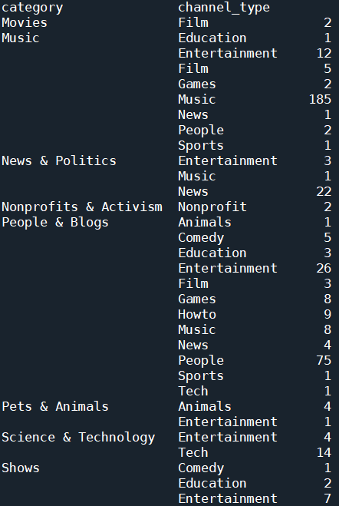

Question 5:
What is the distribution of channel types across different categories?
These numbers show the number of youtube channels .

Slide 12
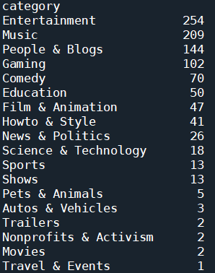
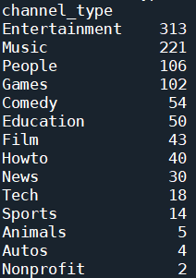
These are the number of youtube channels under each channel type. 313 youtube channels are of Entertainment type while only 2 youtube channels are of nonprofit type.
These are the number of youtube channels under each category. Entertainment tops the list with 254 youtube channels while under Travel & Events there is only one youtube channel

Slide 13
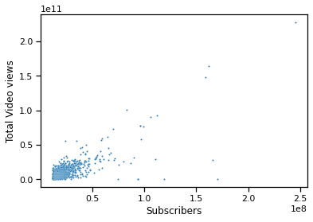
Question 6:
Is there a correlation between the number of subscribers and total video views for YouTube channels?
The correlation coefficient between the number of subscribers and total video views is 0.75. A correlation coefficient of 0.75 indicates a strong positive correlation between the number of subscribers and total video views. It is also evident from the scatter plot. Thus, it can be said that higher the number of subscribers of a youtube channel, higher will be the number of viewers of the videos uploaded by the channel.

Slide 14
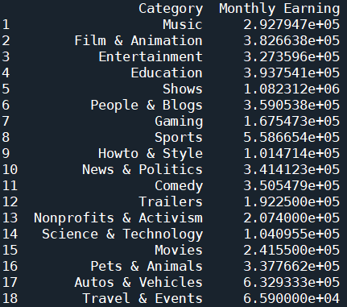
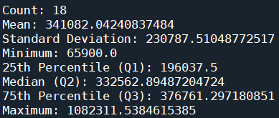
Question 7
How do the monthly earnings vary throughout different categories?
In the dataset, there are two columns called ‘Lowest Monthly Earning’ and ‘Highest Monthly Earning’. So , I have created a separate column of ‘Monthly Earning’ by taking the average of lowest and highest monthly earning as asked in the question to find the monthly earnings. So, I have calculated the average monthly earnings for every category and compare them using bar graph in the next slide. From the statistics, we are also seeing Shows category has the highest monthly earning(1082311.5384615385) and Travel & Events has the lowest monthly earning(65900.0). About 25 percent of categories has monthly earning below 196037.5 and 75 percent of categories has monthly earning below 376761.297180851. The median is 332562.89487204724.

Slide 15
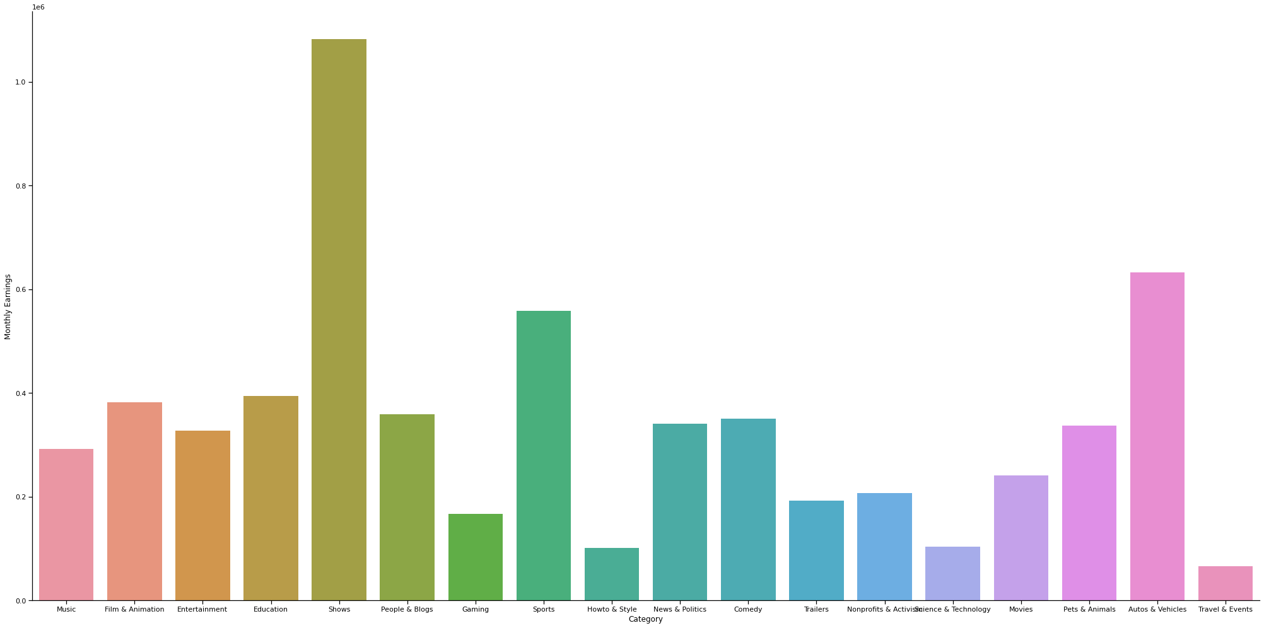
Plot showing the variation of monthly earnings with the categories

Slide 16
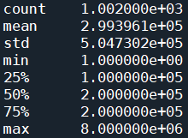
Question 8:
What is the overall trend in subscribers gained in the last 30 days across all channels?
The mean of subscribers gained in last 30 days for all the youtube channels is 299396.1. 25 percent of the youtube channels have gained below 100000 subscribers in last 30 days. 75 percent of the youtube channels have gained below 2000000 subscribers in last 30 days. The median is 200000 which suggests that there is a heavy crowd around 200000. The subscribers gained in last 30 days is highest for MrBeast(8000000.0).The subscribers gained in last 30 days is lowest for BRIGHT SIDE(1.0). The standard deviation is 504730.2 which suggest that there is a great variation.

Slide 17
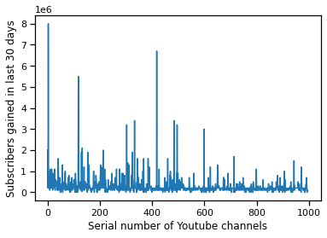
The line plot of the subscribers gained in last 30 days vs Serial number of youtube channels

Slide 18
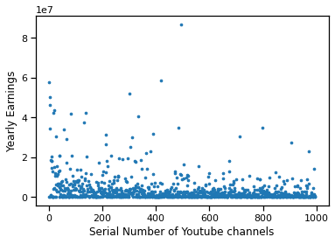
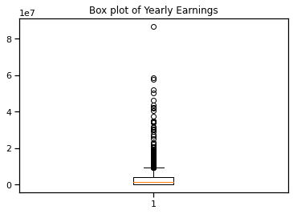
Question 9:
Are there any outliers in terms of yearly earnings from YouTube channels?
To determine the Yearly Earnings, a separate column is created by calculating the average of the ‘Highest Yearly Earnings’ and ‘Lowest Yearly Earnings’ columns. Scatter plots and box plots are then generated to visualize the data. These plots reveal the presence of numerous outliers in the yearly earnings.

Slide 19
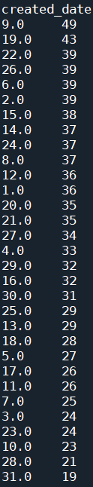
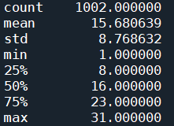
Question 10:
What is the distribution of channel creation dates? Is there any trend over time?
So we can see 25 percent of the youtube channels are formed before 8th of any month, 50 percent of them are created before 16th of a month and 75 percent of them are created before 23rd. Standard deviation is about 8.77 which suggests that the number of YouTube channels created on different dates is fairly consistent. The output which is beside the summary statistics provide information about the number of youtube channels which are created on different dates. On 9th of a month, maximum number of channels are created (49).

Slide 20
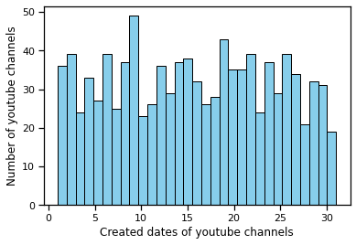
The histogram appears relatively uniform, indicating that the number of YouTube channels created on different dates is fairly consistent. There are some peaks and troughs in the distribution, but no clear increasing or decreasing trend over time.

Slide 21
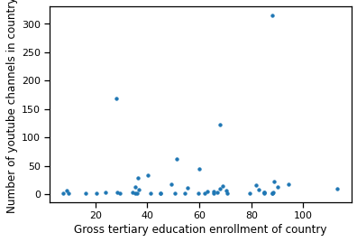
Question 11:
Is there a relationship between gross tertiary education enrollment and the number of YouTube channels in a country?
The correlation coefficient between gross tertiary education enrollment rate and number of youtube channels in a country is 0.11017646654595369. A correlation coefficient of 0.11 indicates a very weak positive correlation between the gross tertiary education enrollment rate and the number of YouTube channels in a country. This suggests that changes in the gross tertiary education enrollment rate have little to no predictive power regarding the number of YouTube channels in a country. It is also evident from the scatterplot.

Slide 22
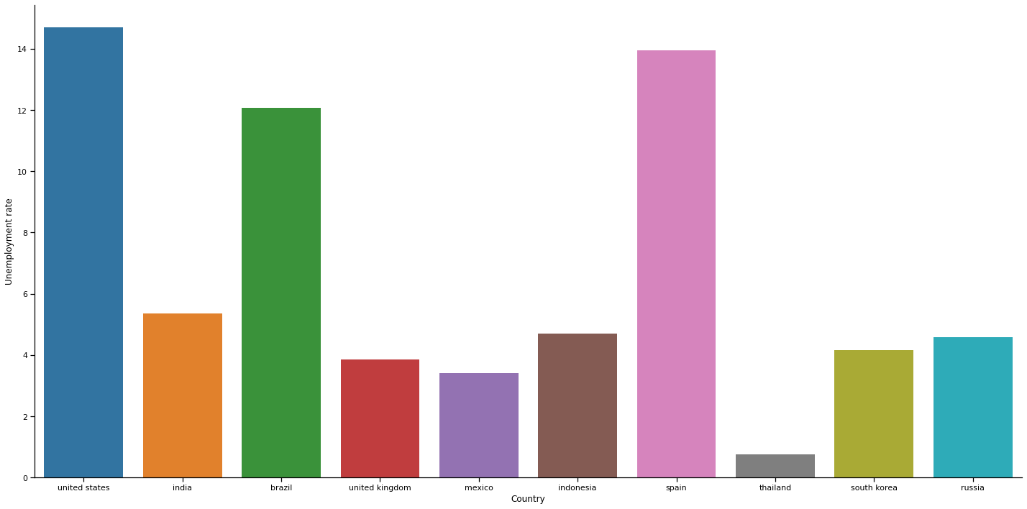
Question 12:
How does the unemployment rate vary among the top 10 countries with the highest number of YouTube channels?

Slide 23
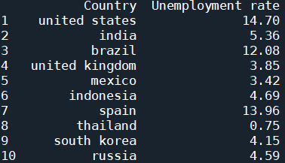
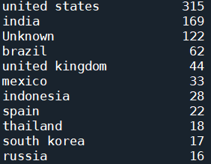
Question 12:
How does the unemployment rate vary among the top 10 countries with the highest number of YouTube channels?
United States with 315 youtube channels has the highest unemployment rate 14.7 whereas Russia with 16 youtube channels has unemployment rate of 4.59.
From the plot we can see there is no clear direct correlation between the number of YouTube channels and the unemployment rate across these countries. Countries with high numbers of YouTube channels (like the United States and Brazil) do not necessarily have low unemployment rates. Some countries with fewer YouTube channels (like Spain) have high unemployment rates, while others (like Thailand) have very low unemployment rates. Hence, the number of YouTube channels in a country does not appear to be directly related to the unemployment rate based on the data presented in this graph. In the dataset there are about 122 youtube channels for which the country is unknown. So, I did not take it into account.

Slide 24
Question 13:
What is the average urban population percentage in countries with YouTube channels?
The average urban population percentage in countries with youtube channels is 71.31. This high percentage suggests that the presence of YouTube channels is more prevalent in countries with a significant urban population, reflecting the influence of urbanization on digital engagement and content creation.

Slide 25
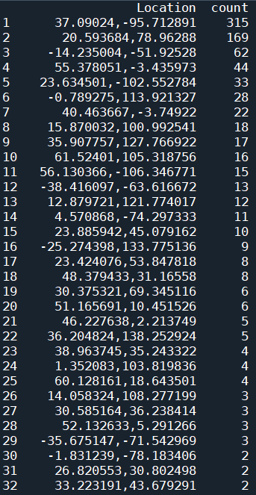
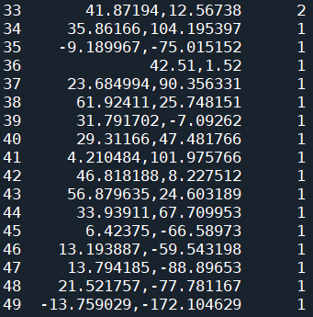
Question 14:
Are there any patterns in the distribution of YouTube channels based on latitude and longitude coordinates?
Here, I have made a separate column called ‘Location’ by concatenating the ‘Latitude’ and ‘Longitude’ values . I have dropped the latitudes and longitudes of the Unknown countries. The count column represents the number of youtube channels in that location. We can see United States (37.09024, -95.712891) has the highest count of YouTube channels (315). India (20.593684, 78.96288) follows with a significant number of channels (169). It suggests these countries have regions with higher internet penetration, content creation activity, or larger populations. Other countries like Brazil, the UK, and Mexico also show notable counts, indicating active content creation.

Slide 26
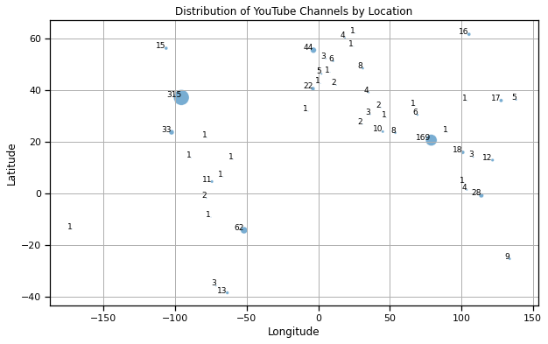
Distribution of Youtube channels by latitudes and longitudes

Slide 27
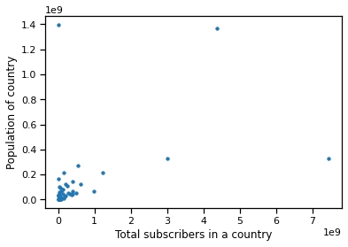
Question 15:
What is the correlation between the number of subscribers and the population of a country?
The correlation coefficient between number of subscribers and population of a country is 0.45. The value 0.45 suggests a moderate relationship between the two variables. Since the correlation is not very high, it indicates that there are some other influencing factors besides population size that affect the number of YouTube subscribers in a country.

Slide 28
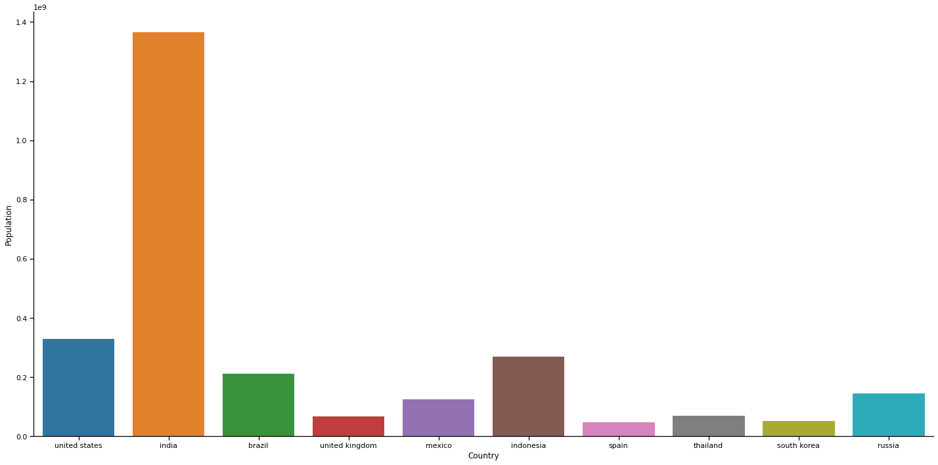
Question 16:
How do the top 10 countries with the highest number of YouTube channels compare in terms of their total population?

Slide 29
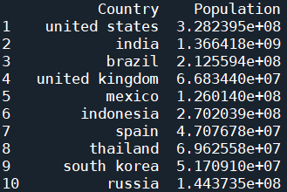
Question 16:
How do the top 10 countries with the highest number of YouTube channels compare in terms of their total population?
Countries like India and Indonesia, with large populations, tend to have many YouTube channels. This suggests a higher potential audience and content creator base. Countries like the United States, the United Kingdom, and South Korea have high numbers of YouTube channels relative to their populations, indicating high engagement and possibly better internet infrastructure and access. While population size plays a role in the number of YouTube channels in a country, it is not the sole determinant. Countries with smaller populations can have a high number of YouTube channels due to various factors. The data suggests that both large and smaller populations can support a high number of YouTube channels, reflecting a complex interplay of various socio-economic factors.

Slide 30
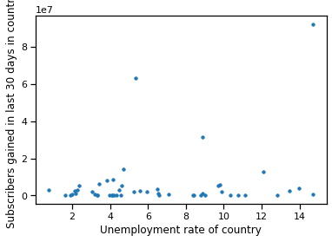
Question 17:
Is there a correlation between the number of subscribers gained in the last 30 days and the unemployment rate in a country?
A correlation coefficient of 0.254 between the number of subscribers gained in the last 30 days and the unemployment rate in a country indicates a weak positive correlation. While there is a slight tendency for countries with higher unemployment rates to gain more YouTube subscribers in the last 30 days, the correlation is weak. This suggests that while unemployment may have some impact, it is not a strong predictor of subscriber growth. Other factors likely play more significant roles in driving subscriber numbers.

Slide 31
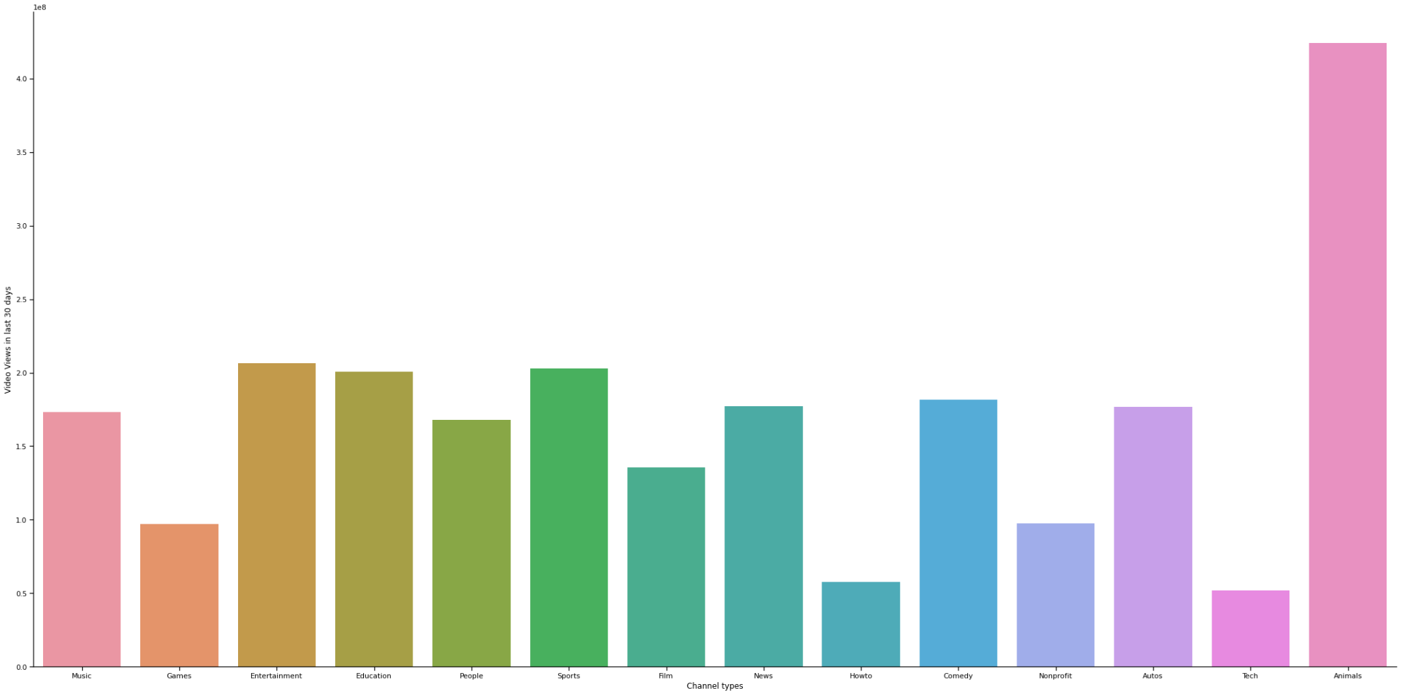
Question 18:
How does the distribution of video views for the last 30 days vary across different channel types?

Slide 32
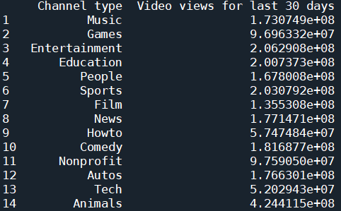
Question 18:
How does the distribution of video views for the last 30 days vary across different channel types?
We can see that video views for last 30 days is highest for the channel type ‘Animals’ (424411483.2) indicating very strong viewer interest and engagement in this category while it is lowest for ‘Tech’ (52029429.22) suggesting relatively lower viewer engagement compared to other types of content.

Slide 33
Question 20:
What is the average number of subscribers gained per month since the creation of YouTube channels till now?
The average number of subscribers gained per month since the creation of YouTube channels till now is 198215.61. I have calculated it from the respective creation months of the youtube channels till May 2024.

